Slide 1
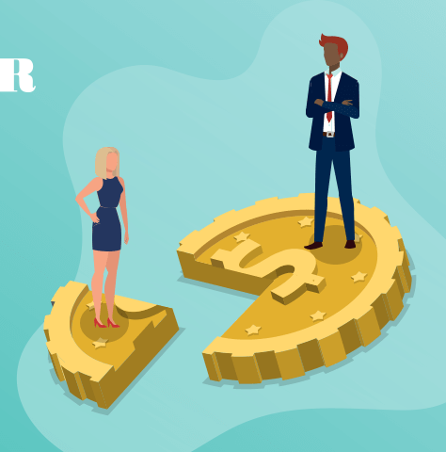
GENDER PAY GAP
By Namrata Kamble

Slide 2

Agenda
analysis
conclusion
Solution

Slide 3
H
Hypothesis
Women are paid less compared to men in UK’s Sport clubs
?
question
What are the top 10 sport clubs (SIC 93120) companies having the highest Mean % difference between male and female hourly pay?

Slide 4

What is gender pay gap ?
The gender pay gap in an organization is the difference between the average hourly wage of all men and all women in the workforce.

Slide 6
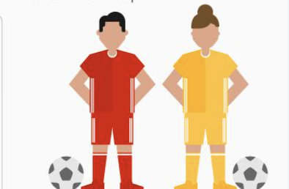
SIC CODE 93120
SPORT CLUBS

Slide 7
TOTAL 27 COMPANIES
SIC code 93120 –sport clubs
20
LARGE GAP
GAP >= 60%
2
MEDIUM GAP
GAP IS BETWEEN 30% TO 59%
5
SMALL GAP
GAP =< 29%

Slide 8



SPORT CLUBS WITH HIGHEST MEAN PAY GAP
99 %
91.6 %
91 %
250 - 499
1000 - 4999
500-999

Slide 9
BONUS
Mean % difference between male and female bonus pay

Slide 10




How many male and female RECIEVED A bonus
BIRMINGHAM CITY FOOTBALL CLUB PLC
CHELSEA FOOTBALL CLUB LIMITED
MANCHESTER CITY FOOTBALL CLUB LIMITED
4%
2%
18.1%
15.1%
51.7%
65.4%

Slide 11
The quartile pay bands

Slide 12


CONCLUSION
less hourly pay
less bonus PAID
FEWER number of females RECIEVED bonus
FEW females in higher PAY quartile
high hourly pay
high bonus PAID
more number of men RECIEVED bonus
More men in higher PAY quartile

Slide 13



SOLUTION
ENSURE TRANSPARENCY
Address unconscious bias
Conduct a pay audit
Companies should be transparent about their pay policies and provide clear information about how pay is determined.
This can help ensure that employees understand how they are being paid and that there are no hidden biases in the pay structure.
Companies should provide training and education to help managers and employees recognize and address unconscious bias.
Companies can conduct a pay audit to identify any discrepancies in pay between male and female employees.

Slide 14

“Let woman share the rights and she will emulate the virtues of man.”

Slide 15

The end !

Slide 16

QUESTIONS?

